Slide 1
MPLS FUNDAMENTALS
Spring 2019

Slide 2
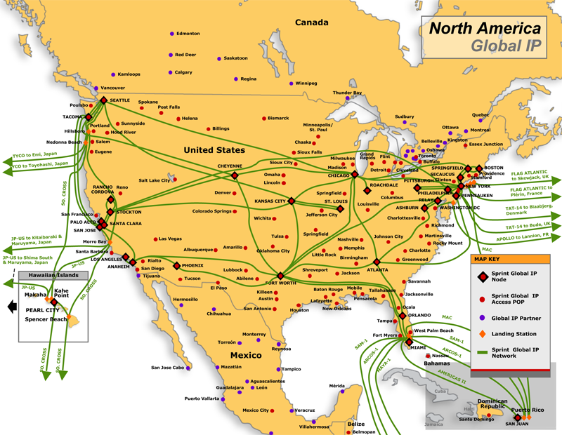
North American Long haul Networks
Notes:
Reference: North America Long haul networks

Slide 3
Agenda
Why MPLS?
MPLS Architecture
LDP operation
Traffic Engineering
Convergence
MPLS Applications

Slide 4
Switching methods on a Router
Process Switching
Central CPU performs destination IP address lookup for every packet
Fast Switching
Cache built on demand
What about a router on the Internet with 400k routes?
CEF
Pre built switching table
FIB and Adjacency table(ARP, Inverse ARP)
Recursively resolves the N.H
Notes:
Process switching, fast switching and cef (topology based). With cef being the default these days
Manipulating cost, Unequal cost load balancing..(Requires lot of configuration changes. Lookup based on destination IP address)
Traditional reasons for MPLS: Faster lookups. (Layer 2.5)
Adv of MPLS: TE (source can decide) , Multi protocol transport (Similar to IP), Voice, IP, IPV6, IPX, L2VPN, L3 VPN, BGP free core, Creating VC’s can be tedious, Unified Infrastructure

Slide 5
Why MPLS?
Bandwidth utilization
Scalable and easy provisioning
Single infrastructure that supports different applications
Can transport multiple protocols other than IPv4
BGP free Core
VPN services (Overlapping IP spaces)
QoS
Control plane vs Forwarding plane separation
MPLS evolution
Notes:
Process switching, fast switching and cef (topology based). With cef being the default these days
Manipulating cost, Unequal cost load balancing..(Requires lot of configuration changes. Lookup based on destination IP address)
Traditional reasons for MPLS: Faster lookups. (Layer 2.5)
Adv of MPLS: TE (source can decide) , Multi protocol transport (Similar to IP), Voice, IP, IPV6, IPX, L2VPN, L3 VPN

Slide 6
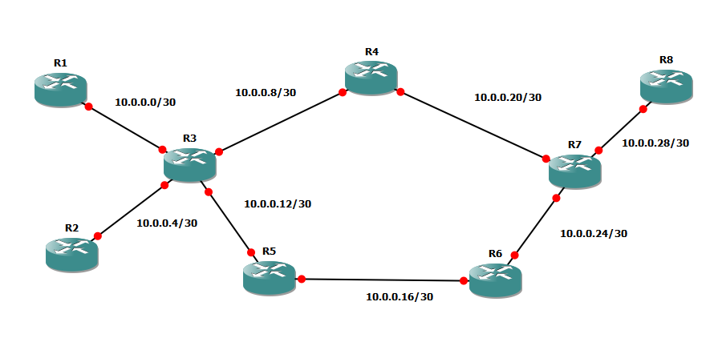
Traffic Engineering

Slide 7
MPLS Overview
MPLS versus Frame Relay
Notes:
MPLS – Distribution of labels taken care automatically via LDP.
Protocol ID in MPLS? How will LSR’s know what is the MPLS payload?

Slide 8
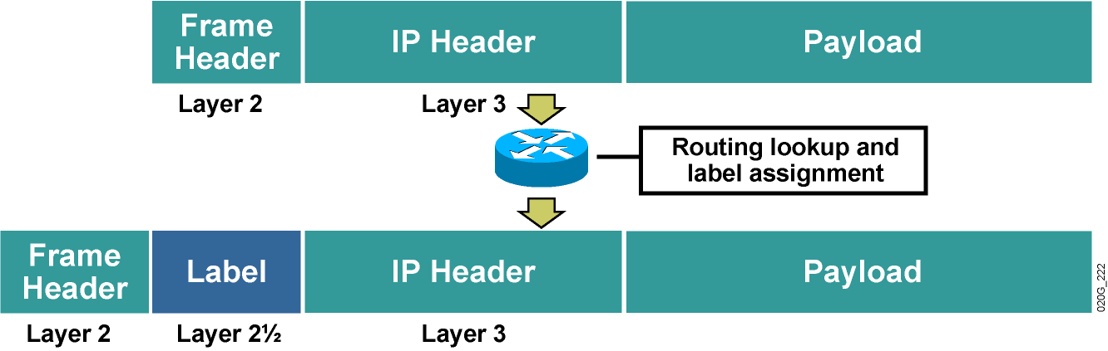
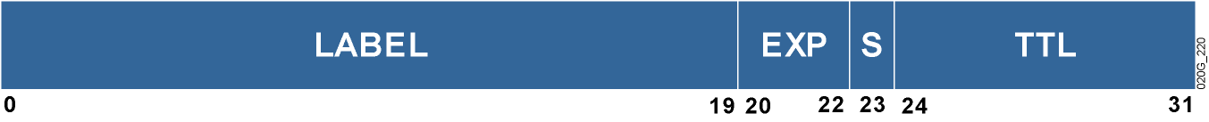
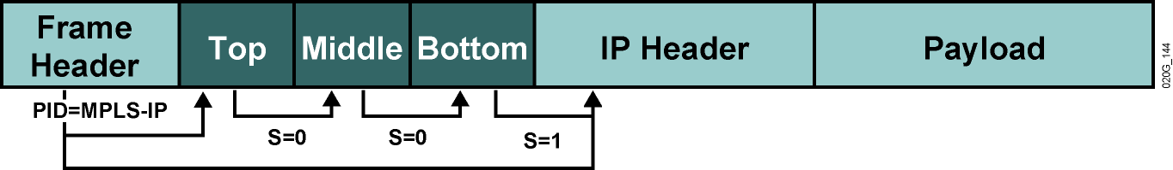
MPLS Overview
MPLS Header
Notes:
MPLS – Distribution of labels taken care automatically via LDP.
Protocol ID in MPLS? How will LSR’s know what is the MPLS payload?

Slide 9
Question?
How does a router identify that it received a labelled packet or an IP packet?
Notes:
LSP’s can be assigned statically (not popular) and dynamically using (LDP,RSVP,BGP)
Running a separate protocol for distributing labels.
Ingress determines the FEC

Slide 10
MPLS Terminologies
RIB, FIB, LIB, LFIB & Adjacency Table
Ingress, Egress, Transit
Upstream, Downstream, Edge LSR, LSR, LSP (Nested LSP), FEC
Local bindings, Remote bindings & Label Operations (Push, Pop, swap)
Protocols to distribute labels( Static LSP, LDP, RSVP,BGP)
Notes:
LSP’s can be assigned statically (not popular) and dynamically using (LDP,RSVP,BGP)
Running a separate protocol for distributing labels.
Ingress determines the FEC

Slide 11
MPLS Terminologies
Notes:
LSP’s can be assigned statically (not popular) and dynamically using (LDP,RSVP,BGP)
Running a separate protocol for distributing labels.
Ingress determines the FEC

Slide 12
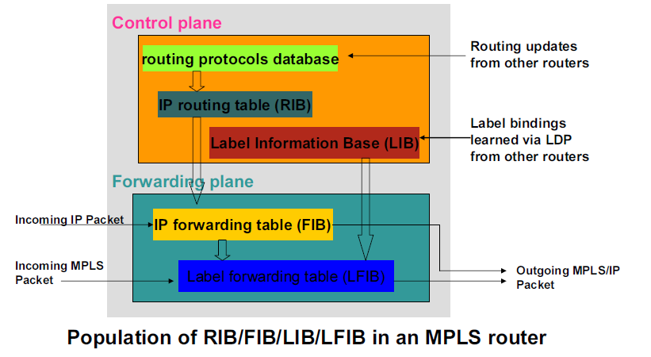
MPLS Architecture
Notes:
LSP’s can be assigned statically (not popular) and dynamically using (LDP,RSVP,BGP)
How does a router know whether it’s a IP packet or a labelled packet? Label lookup vs cef lookup

Slide 13
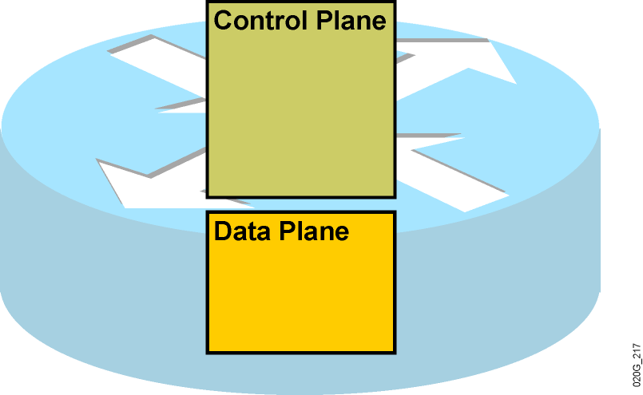
MPLS Architecture
Control plane and Data plane

Slide 14
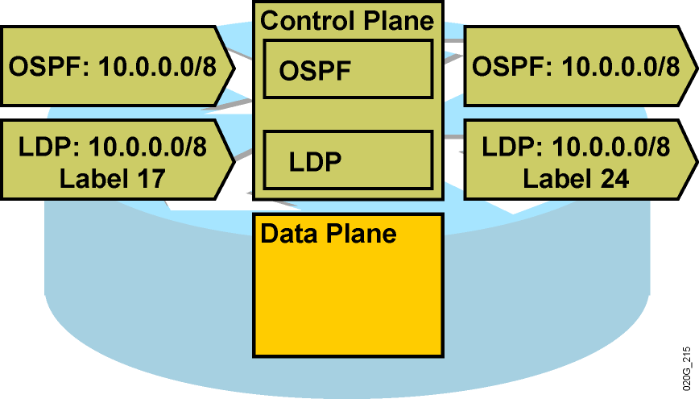
MPLS Architecture

Slide 15
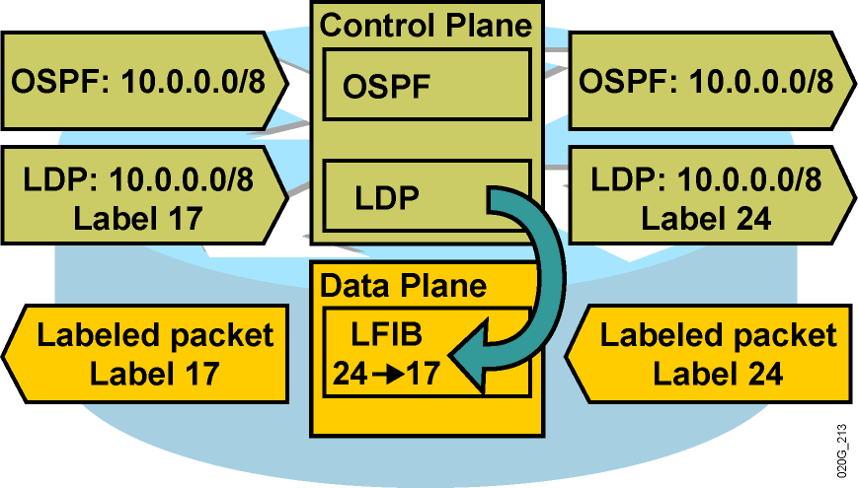
MPLS Architecture

Slide 16
Different MPLS Modes
MPLS Label Spaces ( Per-platform & Per-Interface)
Label Distribution modes (DoD, UD)
Label Retention modes (LLR, CLR)
LSP control modes (Independent & Ordered)

Slide 17


Overview of LDP
Upstream
LDP peer
Net: 10.0.0.0
Label: 17
LSR
Net: 10.0.0.0
Label: 52
Downstream
LDP peer
Net: 10.0.0.0
Label: 29
3
1
4
5
2
3
MPLS Table
MPLS Table
MPLS Table
In
Out
Advertise
incoming
label
In
Out
Receive
outgoing
label
In
Out
(3, 35)
(1, 17)
(4, 17)
(5, 52)
(2, 52)
(3, 29)
Labels assigned by downstream peer
Limitations
LSPs follow the conventional IGP path
Does not support explicit routing

Slide 18
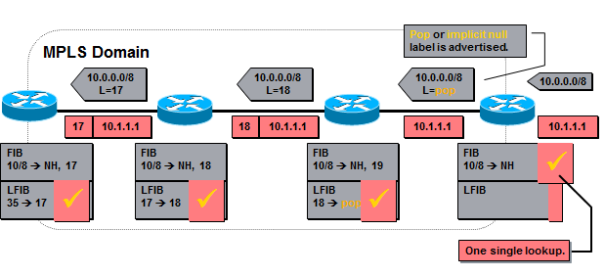
Overview of LDP
Reserved Labels
PHP improves performance in the egress LSR’s( Label stack)
Notes:
Label 0-> Explicit null (EXP bits removed if the label is removed. QOS to be delivered to egress LSR. Label value of 0. Copying QOS to precedence bits in IP )
Label 1->Router Alert label ( Alerts that the packet needs a closer look. Software process.
Label 3-> Implicit Null (Default , egress LSR assigns label 3 to its connected and summarized prefixes, Avoid double lookups, PHP)
Label 14->OAM Alert table
Unreserved range in cisco : 16 – 100,000

Slide 19
Overview of LDP
Discovery of LSR’s running LDP
Session Establishment and maintenance
Advertisement of label mappings
Notifications

Slide 20
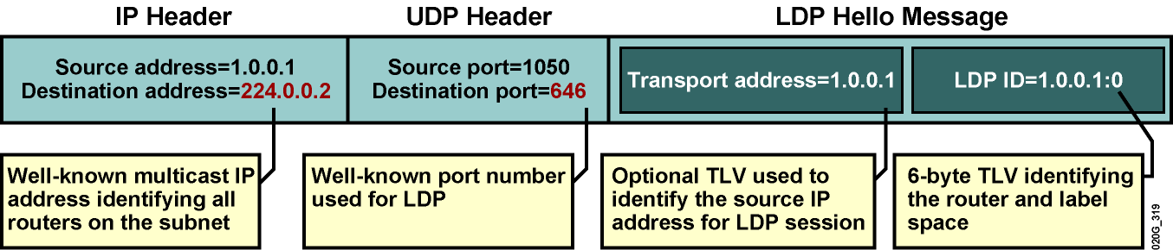
Overview of LDP
Hello messages

Slide 21
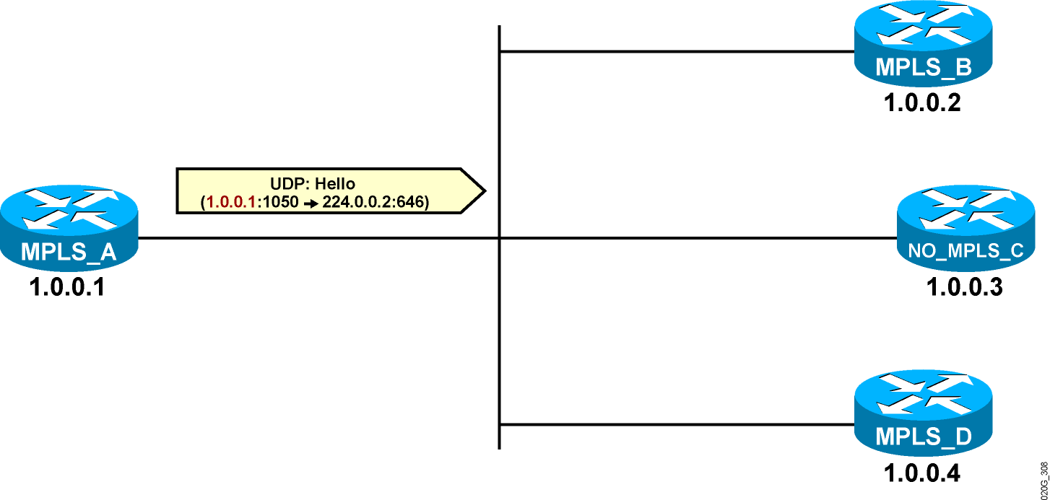
LDP Neighbor Discovery

Slide 22
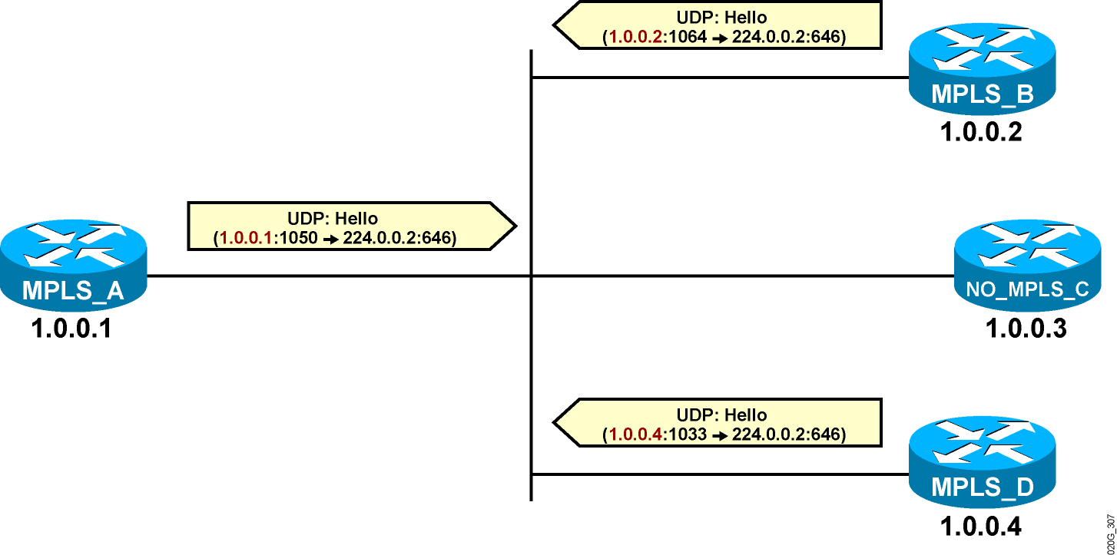
LDP Neighbor Discovery

Slide 23
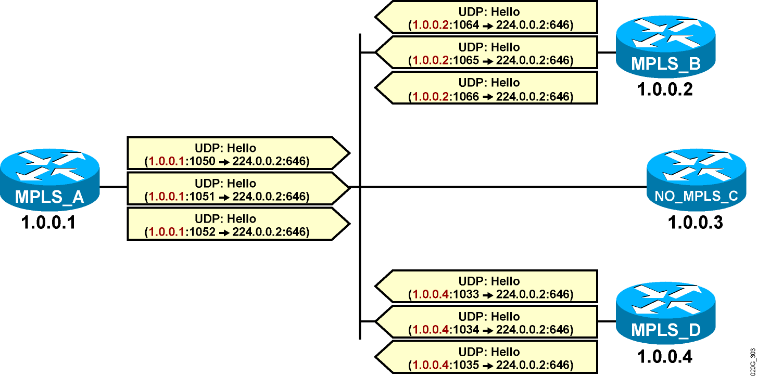
LDP Neighbor Discovery

Slide 24
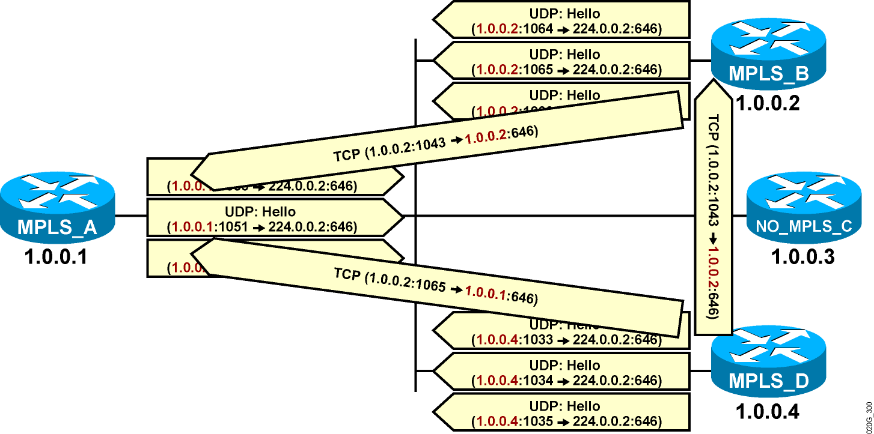
LDP Neighbor Discovery
An LDP session is established from the router with the higher IP address.

Slide 25

LDP Session Negotiation
Peers first exchange initialization messages.
The session is ready to exchange label mappings after receiving the first keepalive.

Slide 26
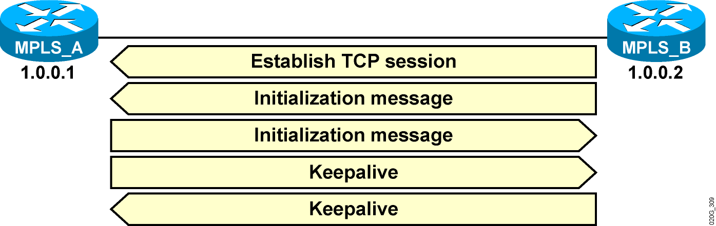
LDP Session Negotiation

Slide 27
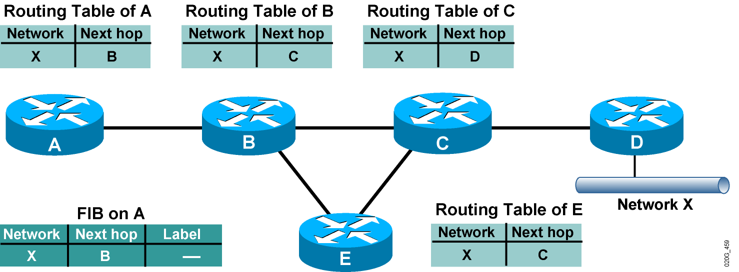
Label Allocation - Building IP Routing Table
IP routing protocols are used to build IP routing tables on all LSRs.
FIBs are built based on IP routing tables with no labeling information.

Slide 28
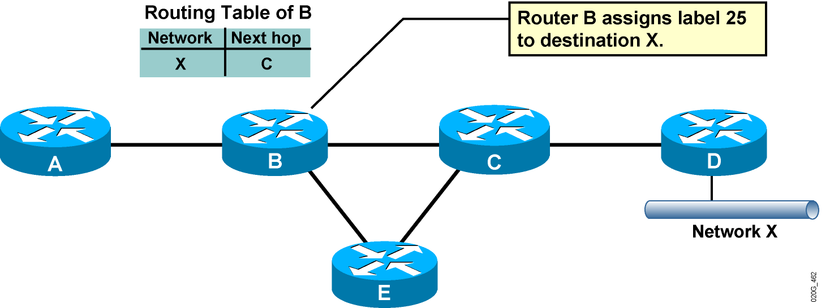
Label Allocation - Allocating Labels
Every LSR allocates a label for every destination in the IP routing table.
Labels have local significance.
Label allocations are asynchronous.

Slide 29
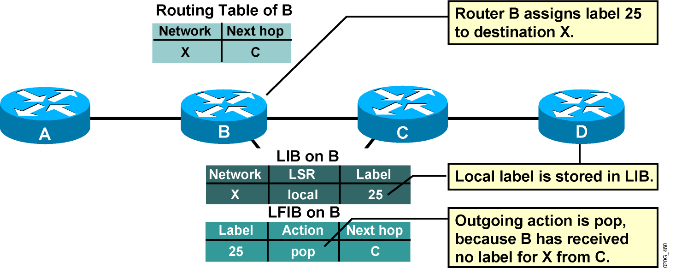
Label Allocation - LIB and LFIB Setup
LIB and LFIB structures have to be initialized on the LSR allocating the label.

Slide 30
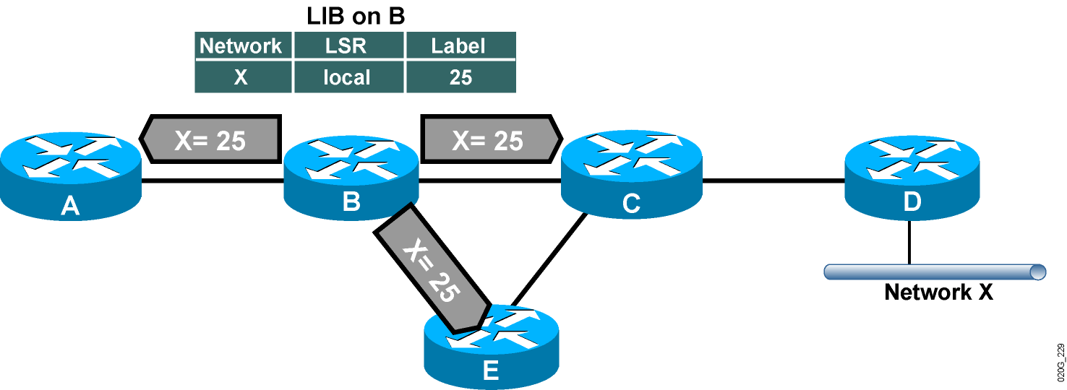
Label Distribution and Advertisement
The allocated label is advertised to all neighbor LSRs, regardless of whether the neighbors are upstream or downstream LSRs for the destination.

Slide 31
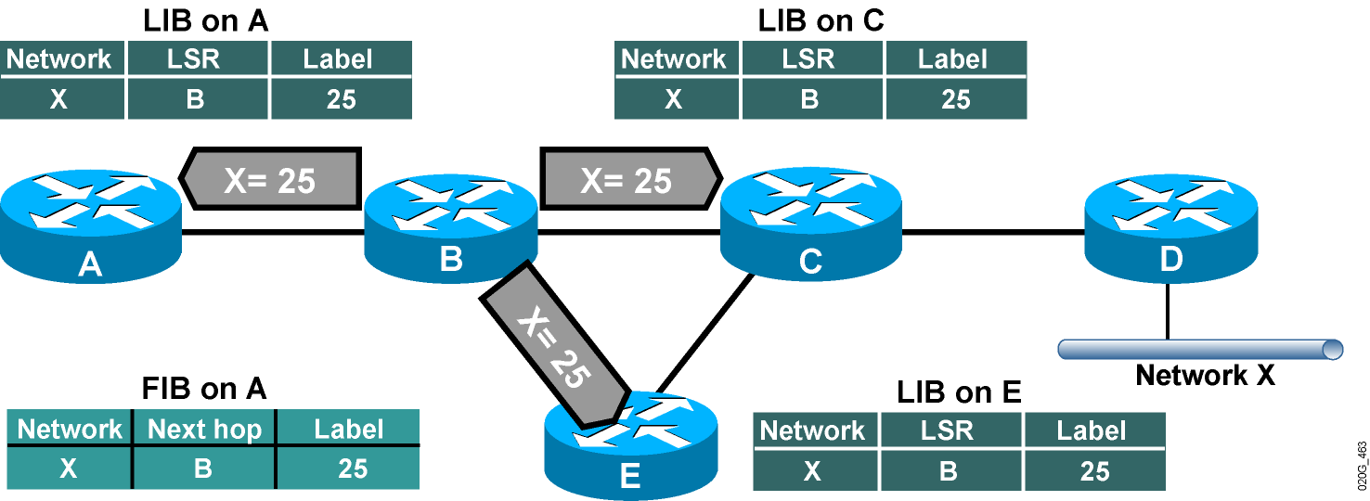
Label Distribution and Advertisement (Cont.)
Every LSR stores the received label in its LIB.
Edge LSRs that receive the label from their next hop also store the label information in the FIB.

Slide 32
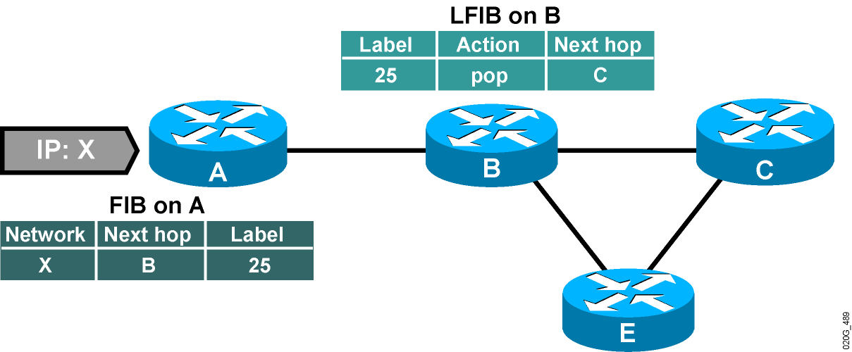
Label Distribution and Advertisement (Cont.)
Forwarded IP packets are labeled only on the path segments where the labels have already been assigned.

Slide 33
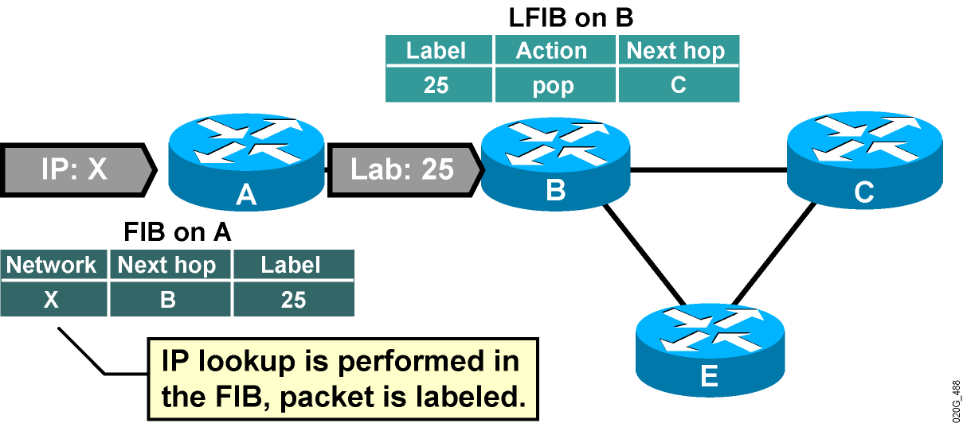
Label Distribution and Advertisement (Cont.)
Forwarded IP packets are labeled only on the path segments where the labels have already been assigned.

Slide 34
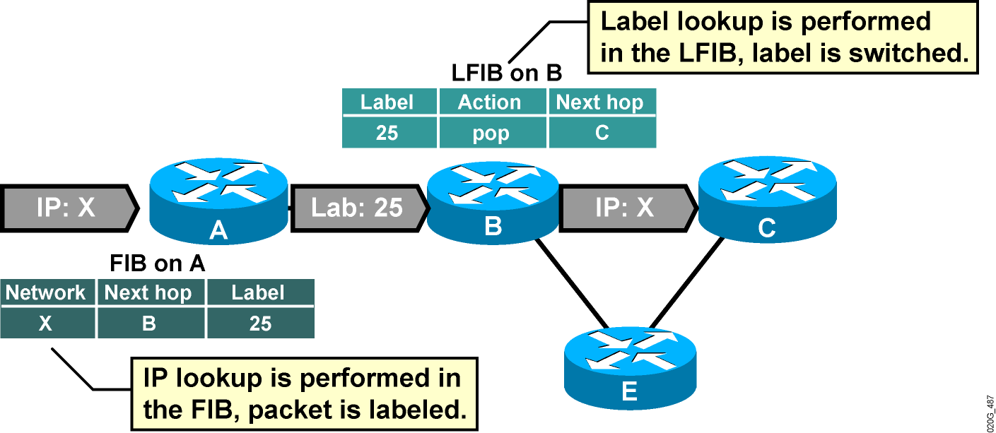
Label Distribution and Advertisement (Cont.)
Forwarded IP packets are labeled only on the path segments where the labels have already been assigned.

Slide 35
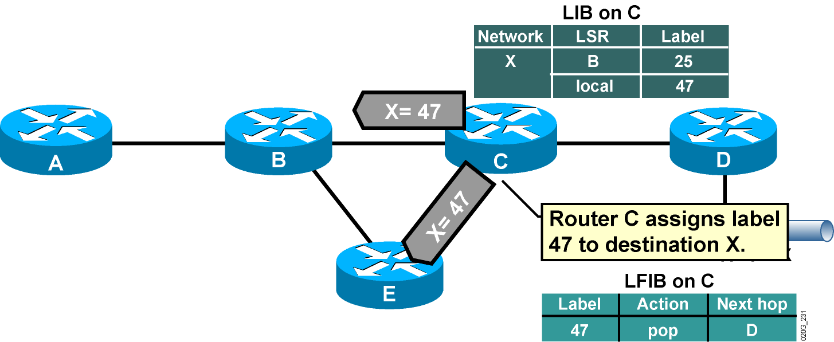
Label Distribution and Advertisement (Cont.)
Every LSR will eventually assign a label for every destination.

Slide 36
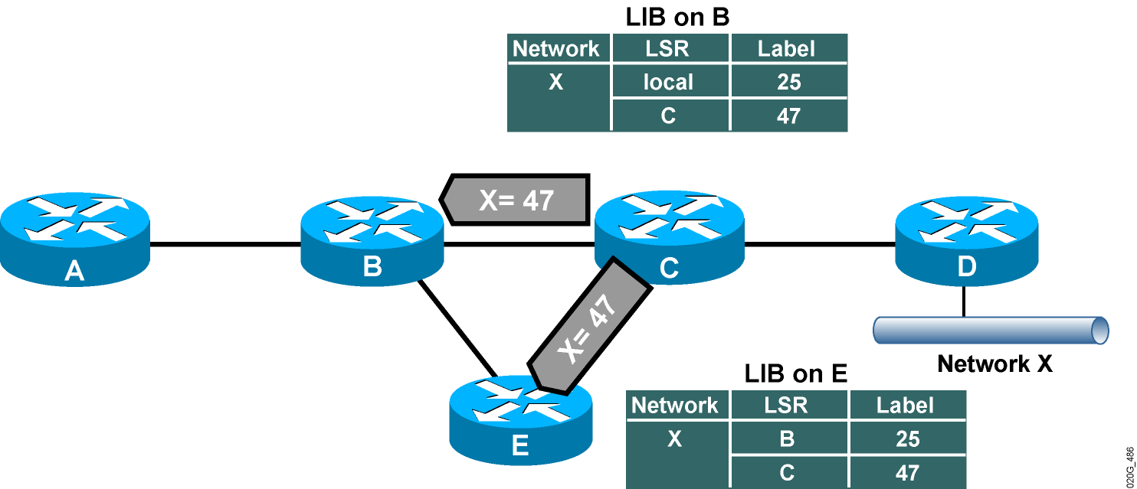
Label Distribution and Advertisement (Cont.) Receiving Label Advertisement
Every LSR stores received information in its LIB.
LSRs that receive their label from their next hop LSR will also populate the IP forwarding table (FIB).

Slide 37
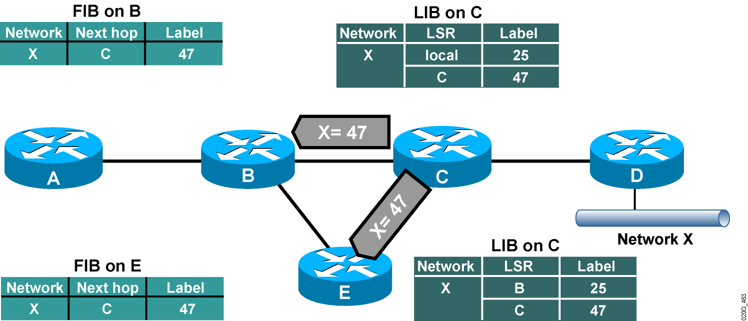
Label Distribution and Advertisement (Cont.) Receiving Label Advertisement
Every LSR stores received information in its LIB.
LSRs that receive their label from their next hop LSR will also populate the IP forwarding table (FIB).

Slide 38
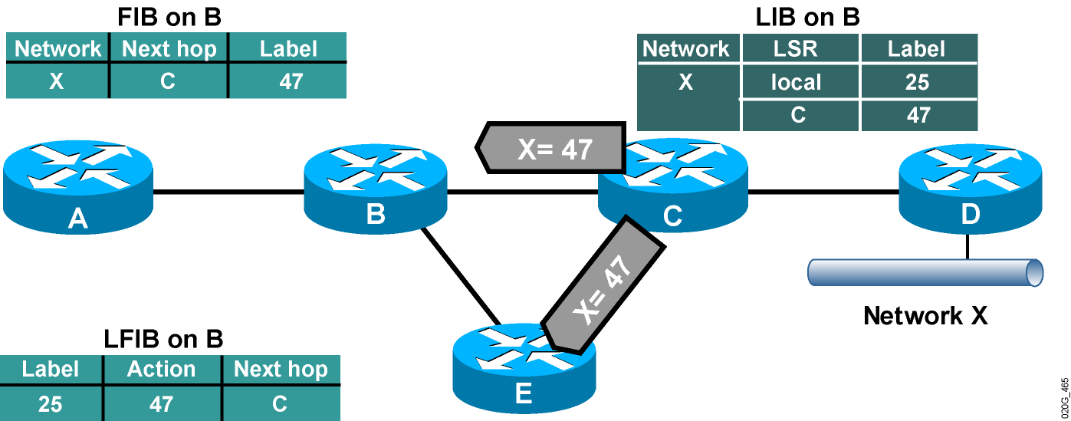
Populating LFIB
Router B has already assigned a label to network X and created an entry in the LFIB.
The outgoing label is inserted in the LFIB after the label is received from the next hop LSR.

Slide 39
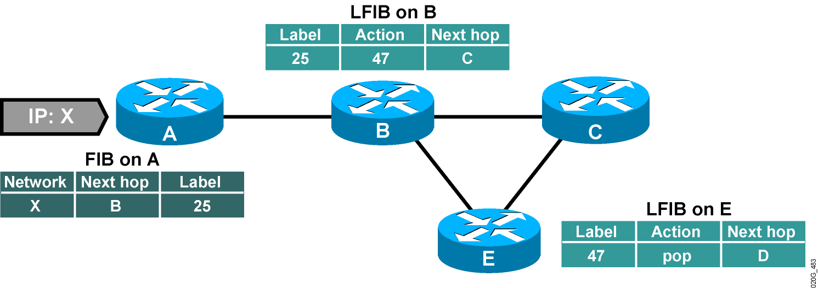
Packet Propagation Across an MPLS Network

Slide 40
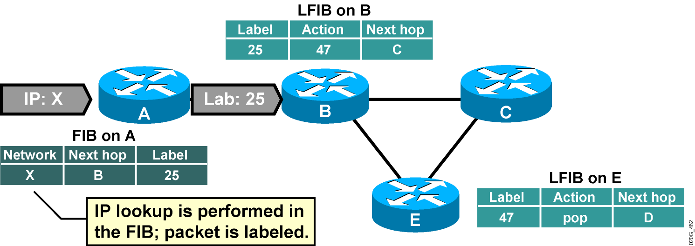
Packet Propagation Across an MPLS Network

Slide 41
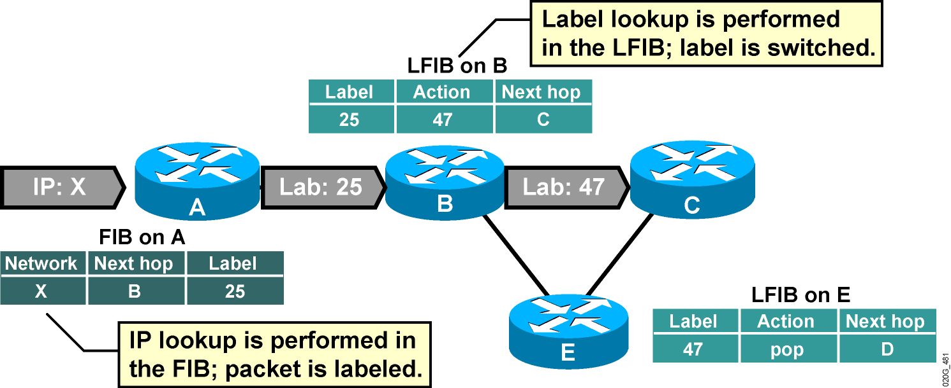
Packet Propagation Across an MPLS Network

Slide 42
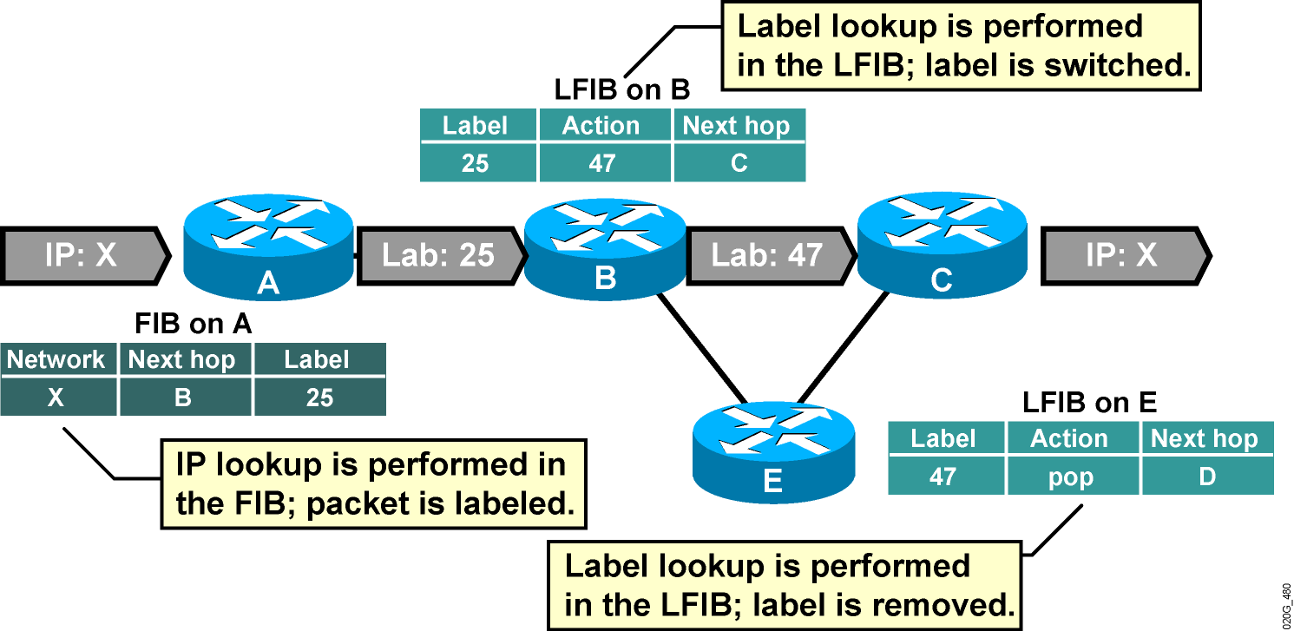
Packet Propagation Across an MPLS Network

Slide 43
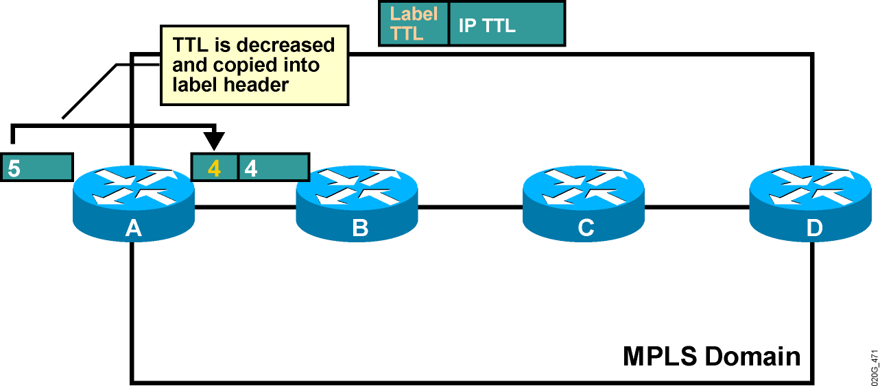
Normal TTL Operation
Cisco routers have TTL propagation enabled by default.
On ingress: TTL is copied from IP header to label header.
On egress: TTL is copied from label header to IP header.

Slide 44
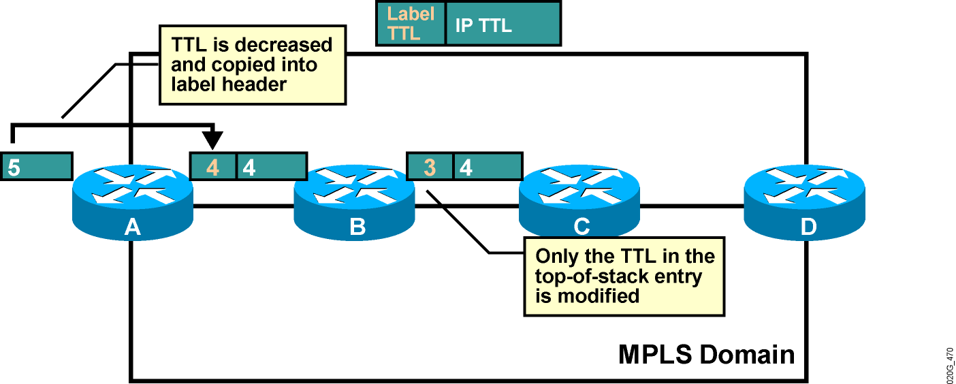
Normal TTL Operation

Slide 45
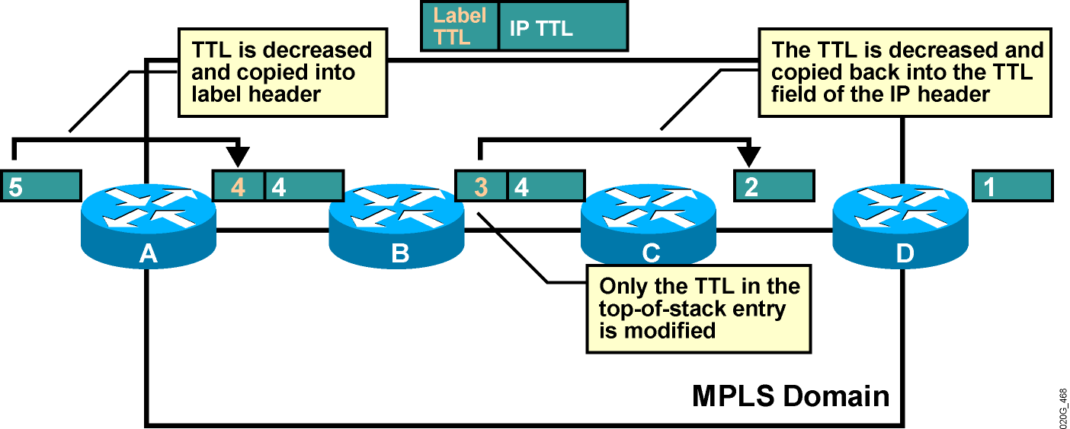
Normal TTL Operation

Slide 46
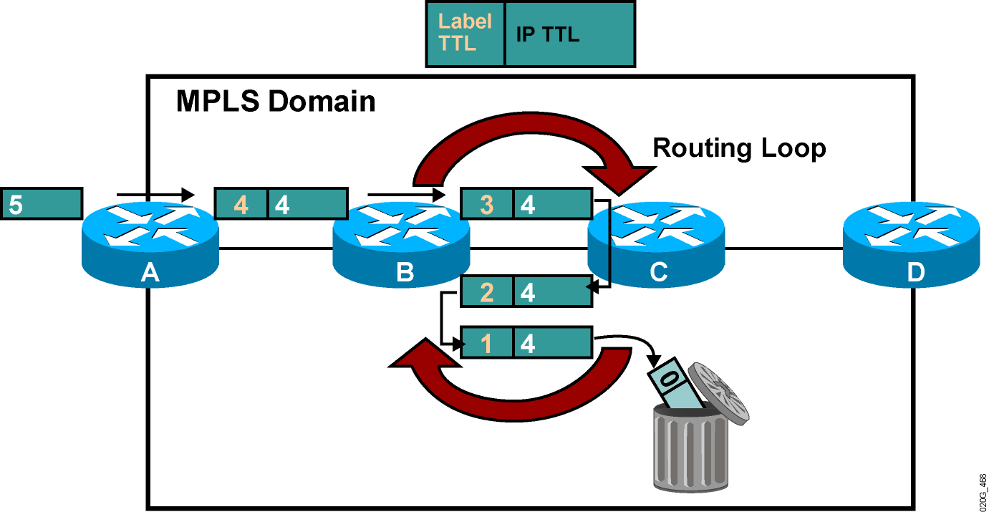
TTL and Loop Detection
Labeled packets are dropped when the TTL is decreased to 0.

Slide 47
Disabling TTL Propagation
TTL propagation can be disabled.
The IP TTL value is not copied into the TTL field of the label, and the label TTL is not copied back into the IP TTL.
Instead, the value 255 is assigned to the label header TTL field on the ingress LSR.
Disabling TTL propagation hides core routers in the MPLS domain.
Traceroute across an MPLS domain does not show any core routers.

Slide 48
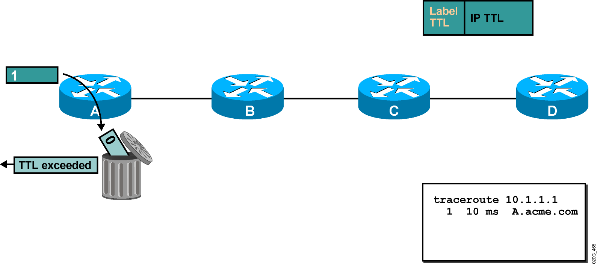
Traceroute with Disabled TTL Propagation
The first traceroute packet (ICMP) that reaches the network is dropped on router A.
An ICMP time-to-live exceeded message is sent to the source from router A.

Slide 49
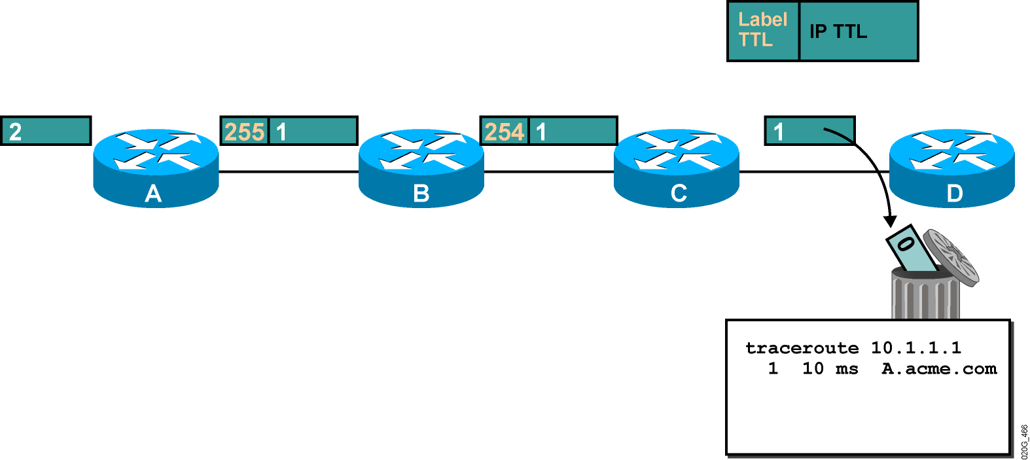
Traceroute with Disabled TTL Propagation (Cont.)

Slide 50
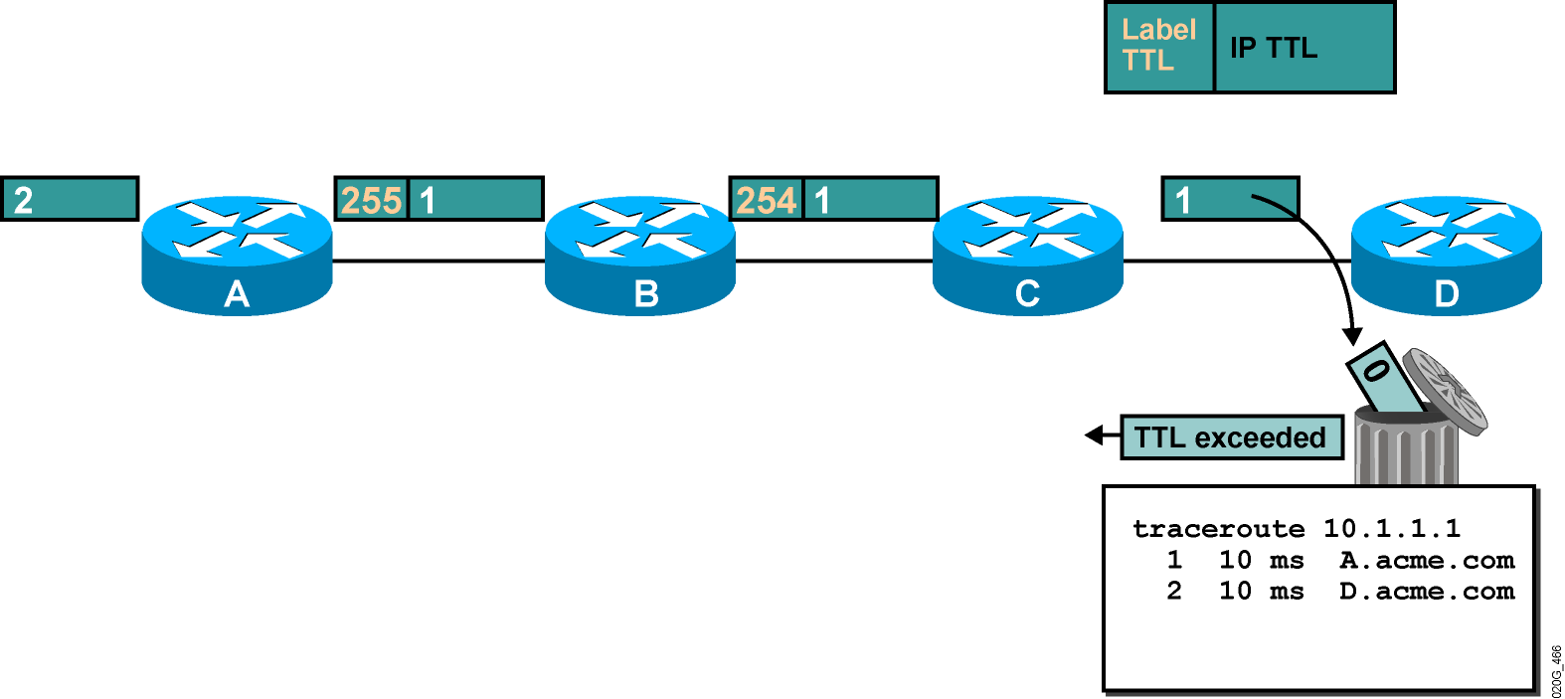
Traceroute with Disabled TTL Propagation (Cont.)
The second traceroute packet that reaches the network is dropped on router D.
An ICMP time-to-live exceeded message is sent to the source from router D.

Slide 51
Impact of Disabling TTL Propagation
Traceroute across an MPLS domain does not show core routers.
TTL propagation has to be disabled on all label switch routers.
Mixed configurations (some LSRs with TTL propagation enabled and some with TTL propagation disabled) could result in faulty traceroute output.
TTL propagation can be enabled for forwarded traffic only—traceroute from LSRs does not use the initial TTL value of 255.

Slide 52
Command Reference
mpls ip
Show mpls interface
Show mpls ldp discovery
Show mpls ldp bindings
Show mpls forwarding-table

Slide 53
AGENDA
Why MPLS?
MPLS Architecture
LDP operation
Traffic Engineering
Convergence
MPLS Applications

Slide 54
Traffic Engineering

Slide 55
Motivations for Traffic Engineering
What is the Path chosen by LDP LSP?
Source-based routing
Takes in to account Bandwidth available on link, delay, attributes
Increase efficiency of bandwidth resources
Override the shortest path chosen by IGP
$$$$ Saving

Slide 56
Traffic Engineering
Popular protocols used for TE
Constrained-Based Shortest path
Bandwidth, Affinity/Link Attributes, Priority
TE tunnels are _________ directional?

Slide 57
THE TE SOLUTION
30Mbps traffic to R5
30Mbps traffic to R5 from R8
R3
R8
R4
R5
R2
20Mbps traffic to R5 from R1
R1
R6
R7
20Mbps traffic to R5
MPLS Labels can be used to engineer explicit paths
Normal path: R8 ➔ R2 ➔ R3 ➔ R4 ➔ R5
Tunnel path: R1 ➔ R2 ➔ R6 ➔ R7 ➔ R4

Slide 58
Traffic Engineering
LSP calculated at the head end
Which Routing protocol to use?

Slide 59
Traffic Engineering Components
Information Distribution
Path selection and calculation or CSPF
Path setup (RSVP)
Trunk Admission Control
Path maintenance
Forwarding traffic on to a TE tunnel
Notes:
IGP to flood TE extensions! OSPF opaque area (LSA 10) and IS-IS uses TLV’s

Slide 60
Path Setup Example
R8
R3
R9
R4
30
10
PATH message
20Mbps
R2
RESV message
Pop
R5
R1
80
60
70
32
50
60
40
49
27
R6
R7
100
80
22
RSVP PATH: R1 ➔ R2 ➔ R6 ➔ R7 ➔ R4 ➔ R9
RSVP RESV: Returns labels and reserves bandwidth on each link Bandwidth available
Returned label via RESV message
80
49

Slide 61
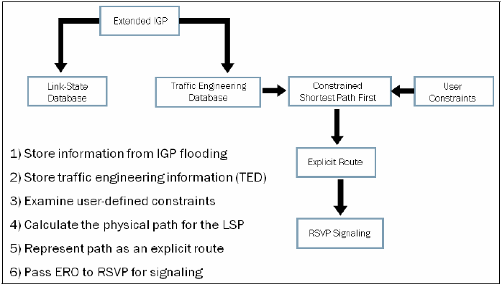
RSVP Operation Overview

Slide 62

Extended RSVP
Ingress
LSR
Explicit route = {R1, R4, R8, R9}
Egress
LSR
PATH
RESV
R1
R4
R8
R9
RSVP message types
PATH: Establish state and request label assignment
RESV: Distribute labels & reserve resources
Runs ingress-to-egress, not end-to-end

Slide 63
Path Message Extensions
Transmitted by ingress LSR towards the egress LSR to establish an LSP tunnel
Addressed to the egress LSR and contains a router alert option in its IP header indicating that the datagram requires special processing by intermediate routers
Includes a number of different RSVP objects
Label Request Object (M)
Session Object (M)
Explicit Route Object-ERO (O)
Record Route object-RRO (O)
Session Attribute Object (O)

Slide 64
Extended RSVP – PATH Message
Ingress
LSR
Explicit route = {R1, R4, R8, R9}
Egress
LSR
PATH
ERO= {R4, R8, R9}
PATH
ERO= {R8, R9}
PATH
ERO= {R9}
R1
R4
R8
R9
Establish Path
State Block
Establish Path
State Block
Establish Path
State Block
Explicit route is passed to R1
R1 transmits a PATH message addressed to R9
Label Request Object
ERO = {strict R4, strict R8, strict R9}
Session object identifies LSP name
Session Attributes: Priority, preemption, and fast reroute
Sender T_Spec: Request bandwidth reservation

Slide 65
Resv Message Extensions
Transmitted from egress LSR toward the ingress LSR in response to the path message
Establishes path state in each LSR by distributing label bindings, requesting resource reservations along the path, and specifying the reservation style
Includes a number of different RSVP objects
Label Object (M)
Session Object (M)
Style Object (M)
Record Route object-RRO (O)

Slide 66
Extended RSVP – RESV Message
Ingress
LSR
Penultimate
LSR
Egress
LSR
2
3
6
2
5
4
RESV
Label = 17
RESV
Label = 20
RESV
Label = 3
R1
R4
R8
R9
MPLS Table
MPLS Table
MPLS Table
In
Out
In
Out
In
Out
IP Route
(2, 17)
(3, 17)
(6, 20)
(2, 20)
(5, Pop)
R9 transmits a RESV message to R8
Label = 3 (indicates that penultimate LSR should Pop header)
Session object to uniquely identify the LSP
R8 and R4
Stores “outbound” label, allocate an “inbound” label
Transmits RESV with inbound label to upstream LSR
R1 binds label to FEC

Slide 67
Other Message Extensions
PathTear Messages
Remove path states as well as dependent reservation states along a path
Initiated by a sender application or by a router when its path state times out
Follow the same path as path messages
ResvTear Messages
Remove reservation states along a path
Initiated by a receiver application or by a router when its reservation state times out
Follow the same path as reservation messages

Slide 68
Other Message Extensions
PathErr Messages
In case of path errors, due to parameter problems in a path message, the router sends a unicast PathErr message to the sender that issued the Path message
ResvErr Messages
When a reservation request fails, a ResvErr message is delivered to all the receivers involved

Slide 69
PathTear & ResvTear Message Flow
Ingress
LSR
ResvTear
PathTear
Egress
LSR
R1
R4
R8
R9
Established LSP
Ingress
LSR
Egress
LSR
Path
Resv
R1
PathErr
R4
R8
ResvErr
R9

Slide 70
Agenda
Why MPLS?
MPLS Architecture
LDP operation
Traffic Engineering
Convergence
MPLS Applications

Slide 71
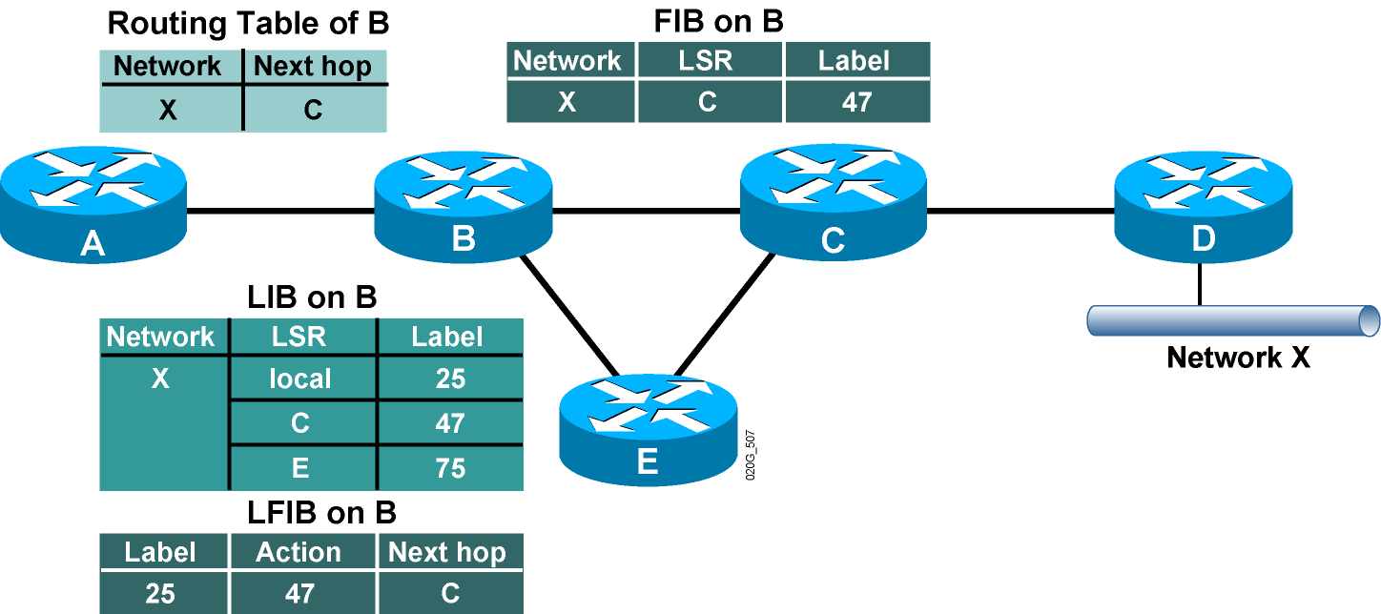
Steady State Description
After the LSRs have exchanged the labels, LIB, LFIB, and FIB data structures are completely populated.

Slide 72
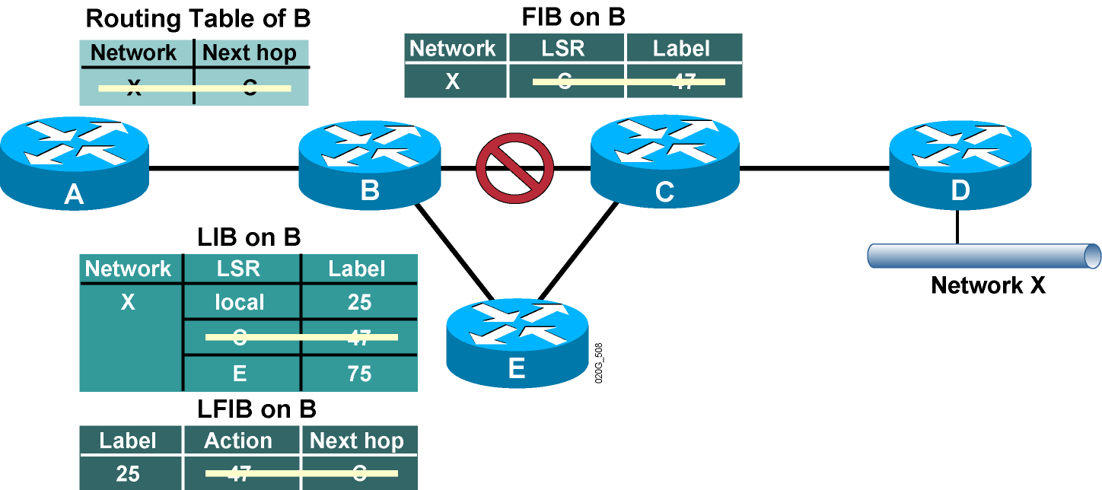
Link Failure Actions
Routing protocol neighbors and LDP neighbors are lost after a link failure.
Entries are removed from various data structures.

Slide 73
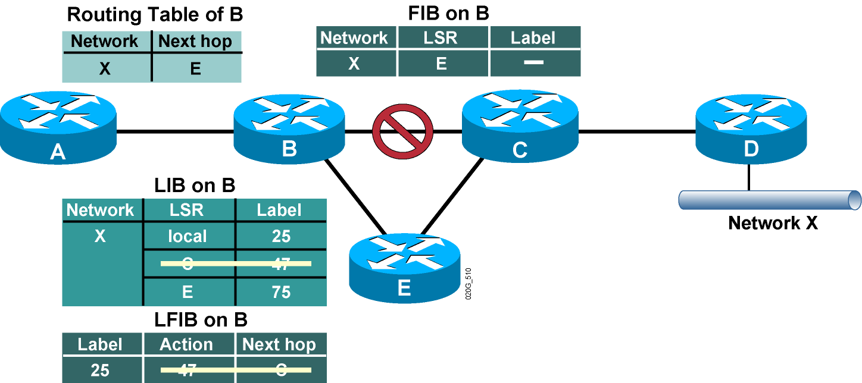
Routing Protocol Convergence
Routing protocols rebuild the IP routing table and the IP forwarding table.

Slide 74
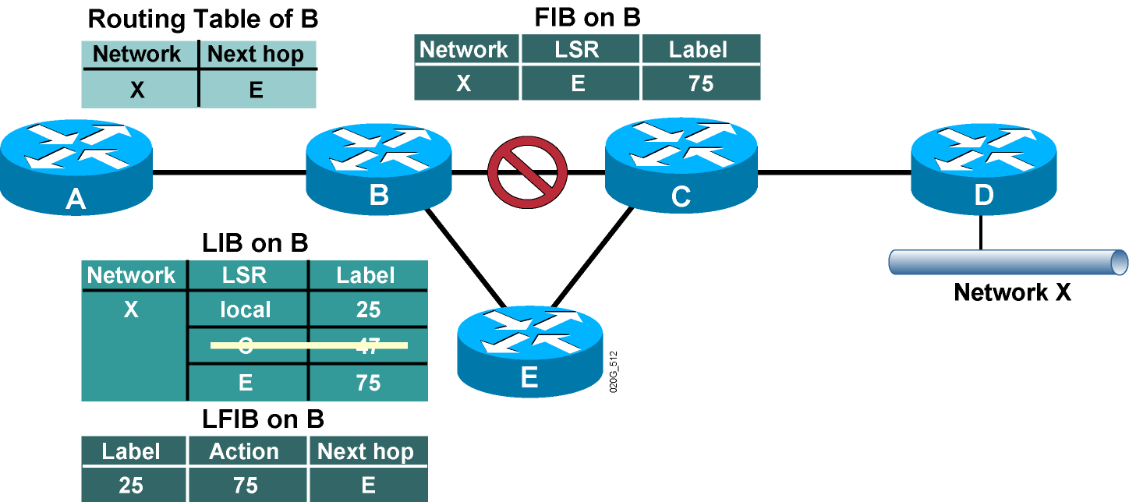
MPLS Convergence
The LFIB and labeling information in the FIB are rebuilt immediately after the routing protocol convergence, based on labels stored in the LIB.

Slide 75
MPLS Convergence After a Link Failure
MPLS convergence in frame-mode MPLS does not affect the overall convergence time.
MPLS convergence occurs immediately after the routing protocol convergence, based on labels already stored in the LIB.

Slide 76

Link Recovery Actions
Routing protocol neighbors are discovered after link recovery.

Slide 77

Link Recovery Actions & IP Routing Convergence
IP routing protocols rebuild the IP routing table.

Slide 78

Link Recovery Actions & IP Routing Convergence
IP routing protocols rebuild the IP routing table.
The FIB and the LFIB are also rebuilt, but the label information might be lacking.

Slide 79
Link Recovery Actions & MPLS Convergence
Routing protocol convergence optimizes the forwarding path after a link recovery.
The LIB might not contain the label from the new next hop by the time the IGP convergence is complete.
End-to-end MPLS connectivity might be intermittently broken after link recovery.
Use MPLS Traffic Engineering for make-before-break recovery.
FRR, Link Protection, Node protection

Slide 80
MPLS Applications
MPLS VPN
Layer 2 VPN (AToM, VPLS)
Layer 3 VPN (VRF, Non-unique IP space)
BGP free core
QoS Guarantee
Notes:
Extending Metro Ethernet ( EOMPLS)
Layer 3 VPN

Slide 81
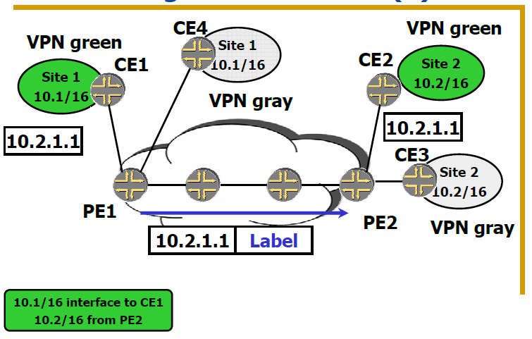
MPLS Applications

Slide 82
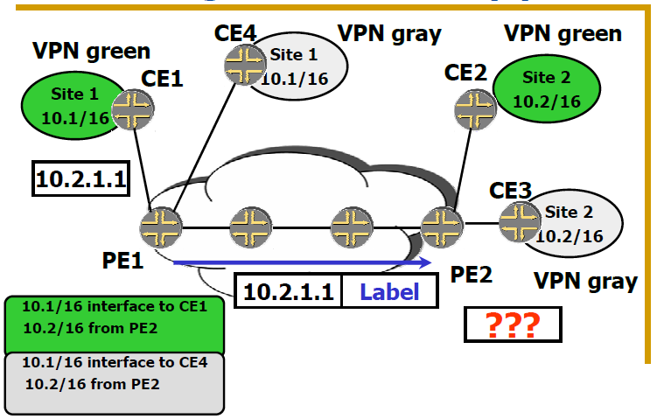
MPLS Applications

Slide 83
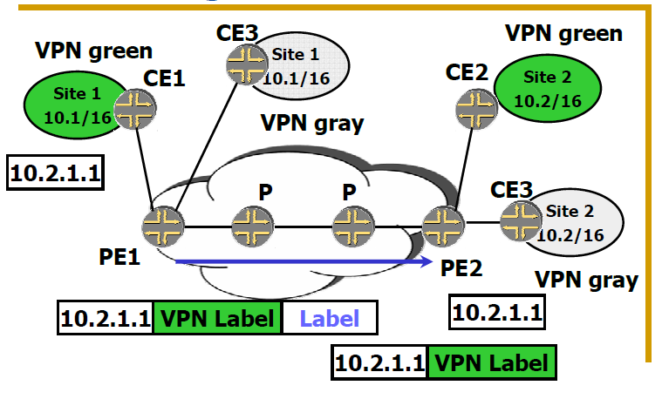
MPLS Applications

Slide 84
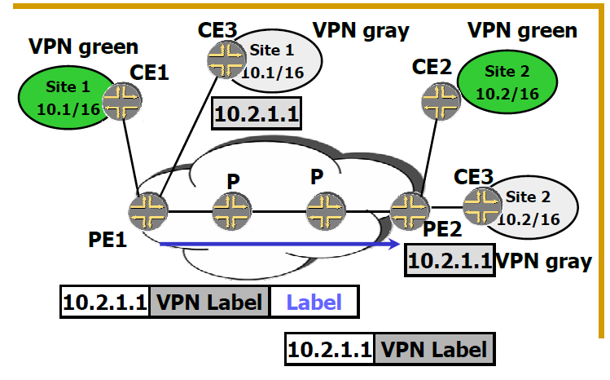
MPLS Applications

Slide 85
References
MPLS Fundamentals, Luc De Ghein
Juniper MPLS Guide
Cisco MPLS Guide

